Slide 1
the Cafe
Website Analysis for Intro to Web Development
Curated by Makeba Waddy
09/15/2025

Slide 2

Objective of the Assignment
Analyze HTML/CSS in a modern template
Critique structure, design, and best practices
Focus: HTML5 semantics, CSS selectors, layout design

Slide 3
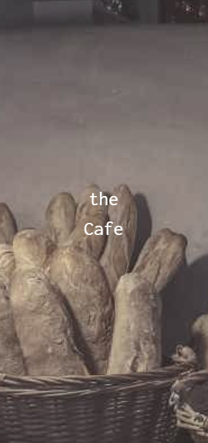
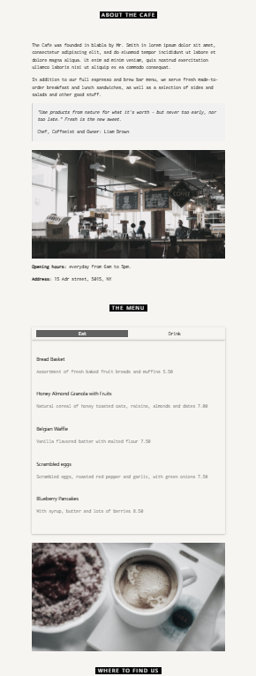
Chosen Template
Café Template from W3.CSS
Reasons why I chose this template:
visually clean
Professional
Responsive
Real-world café example

Slide 4

DOCUMENT HEAD BASICS
<!DOCTYPE html>, <html lang="en">
<meta charset="UTF-8">, viewport for mobile
Linked CSS: W3.CSS CDN + Google Font Inconsolata
<link rel="stylesheet" href="https://www.w3schools.com/w3css/5/w3.css">
<link rel="stylesheet" href="https://fonts.googleapis.com/css?family=Inconsolata">

Slide 5
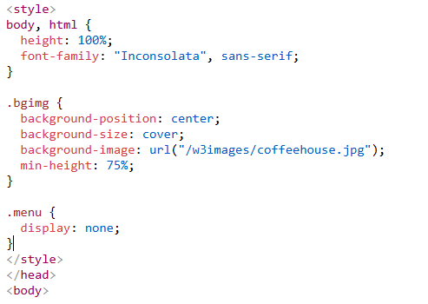
Head Section Elements
Internal <style> sets:
Height: 100% on html, body
default font: Inconsolata
Small custom classes: .bgimg, .menu
Critique: Inline <style> is … fine– for a demo; production would externalize into CSS instead of inline usage.

Slide 6
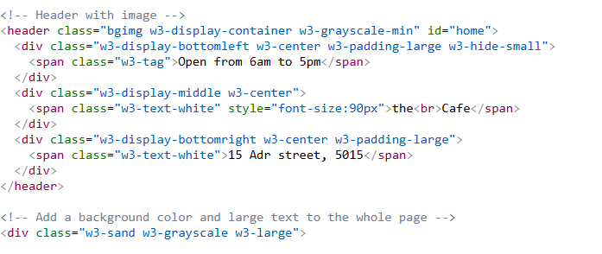
Semantic Landmarks
<header> for hero section
The rest uses <div class="w3-container"> blocks per section
Semantic anchors via id attributes: #home, #about, #menu, #where
Critique: could add <main> wrapping content and <section> elements for stronger semantics.

Slide 7

Navigation Bar
Sticky bar: .w3-top → .w3-row → four .w3-col s3 columns
Anchor links jump to in-page sections (#about, #menu, #where) Code:
Clear, accessible text; consider aria-label for extra a11y.

Slide 8
Hero/Header Composition
<header class="bgimg w3-display-container w3-grayscale-min" id="home">
Three absolutely-positioned overlays using W3 display helpers:
bottom-left tag (“Open from 6am to 5pm”)
centered title (“the Cafe”)
bottom-right address
Critique: “the<br>Cafe” is a simple line-break tactic; could be more semantic with <h1>.

Slide 9
About Section Anatomy
Containerized to max-width:700px with .w3-content
Heading badge style via .w3-tag .w3-wide
Pull-quote block using .w3-panel .w3-leftbar .w3-light-grey
Image then hours/address paragraphs Accessibility: add alt on images.

Slide 10
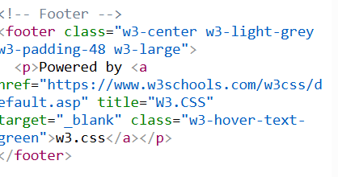
W3.CSS Philosophy (Utility-First)
Layout via .w3-row + .w3-col s#
Spacing via .w3-padding-*, .w3-margin-*
Color via .w3-black, .w3-light-grey, .w3-sand
Note: Similar mental model to Bootstrap/Tailwind utilities.

Slide 11
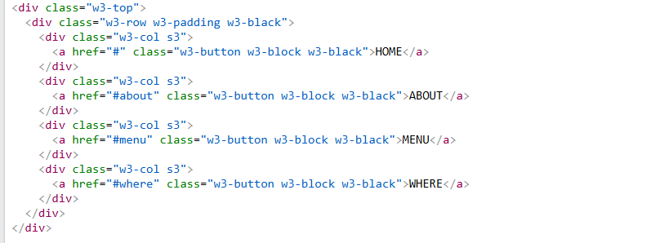
Grid in the Navbar
.w3-row with four equal cols .w3-col s3 ⇒ 12-column grid
I noticed automatic stacking on very small screens handled by W3.CSS
Critique: For true accessibility, consider nav element + role="navigation".

Slide 12
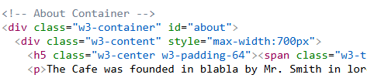
Content Width & Readability
Repeated pattern: .w3-container → .w3-content (700px)
Pros: predictable line length; good for long text
Cons: one fixed max width; might add breakpoints for larger screens

Slide 13
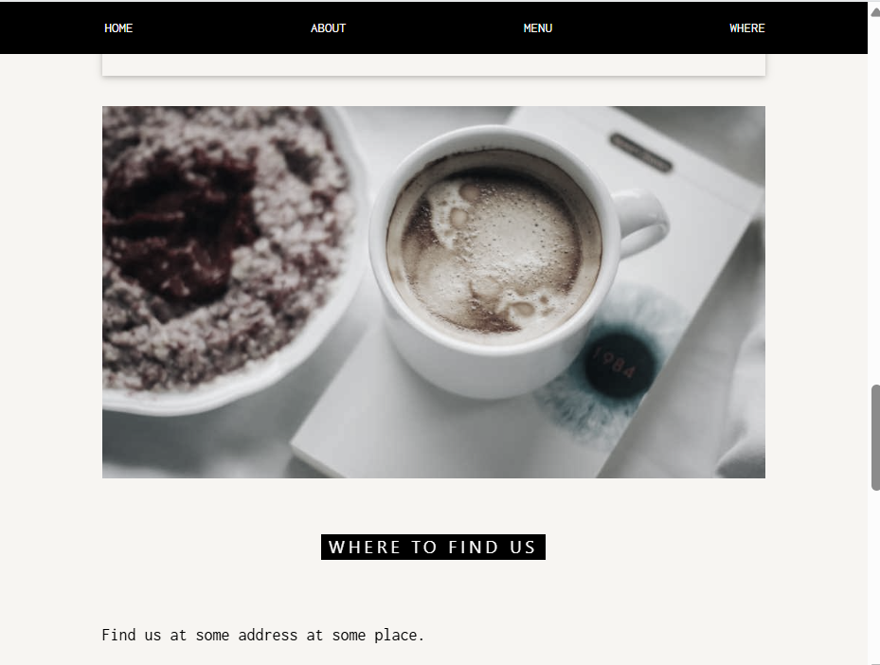
Visual Hierarchy via Utilities
Badges: .w3-tag .w3-wide
Cards: .w3-card
Emphasis: .w3-text-grey, .w3-grayscale-min
Design call: monochrome + photography keeps it calm and café-like.

Slide 14
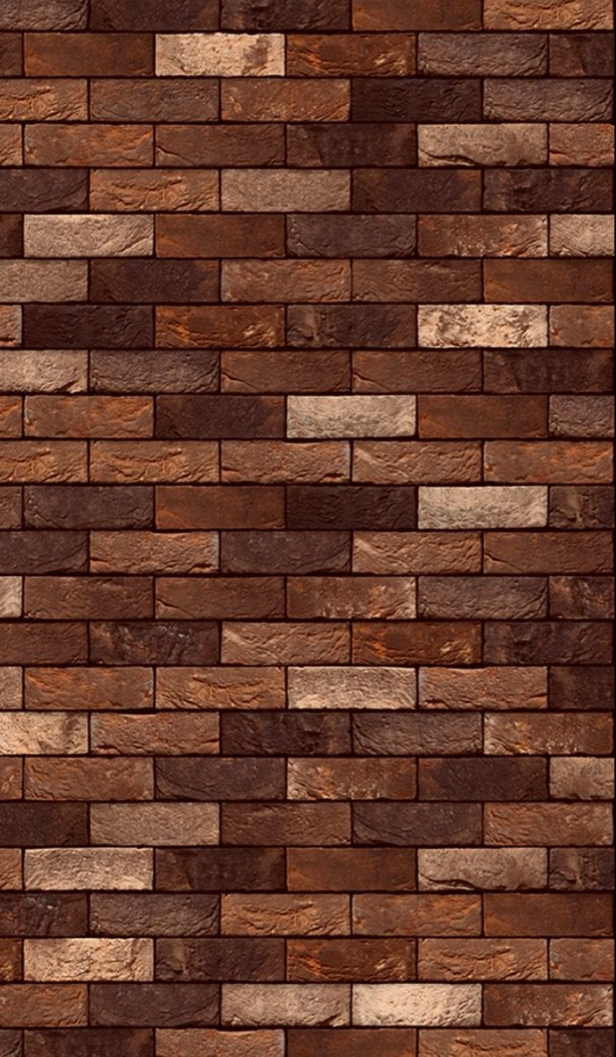
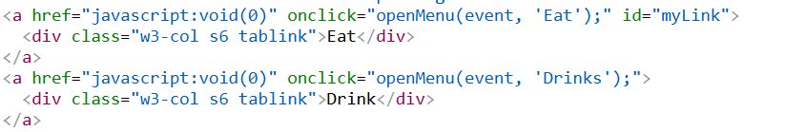
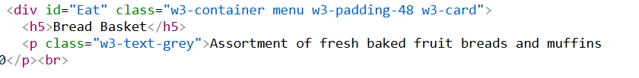

Tabbed Menu: Markup
Two tab triggers:
Two panels with matching IDs:
.menu { display: none; } hides panels by default.

Slide 15
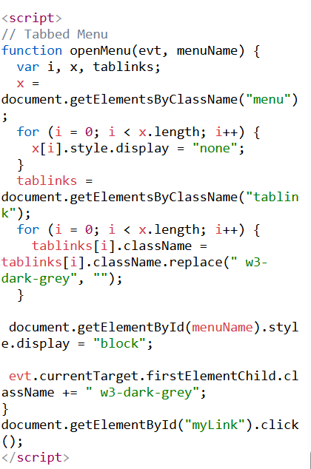
Tabbed Menu: Script Logic
Core algorithm:
hide all .menu panels
remove w3-dark-grey from all .tablinks
show selected panel by id
add w3-dark-grey to clicked tab
Auto-open default tab: document.getElementById("myLink").click();
Critique: minimal, readable; could decouple JS from inline onclick with addEventListener.

Slide 16
Contact Section
Pros: simple, no heavy framework
Improvements:
Use buttons instead of anchors with javascript:void(0)
Add role="tablist", role="tab", aria-selected, aria-controls
Keyboard support (Left/Right to switch tabs)

Slide 17
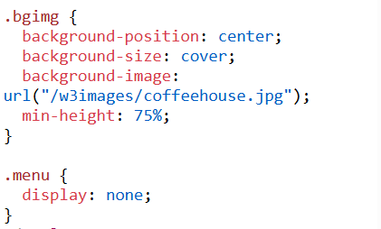
Custom CSS Classes
bgimg → hero background sizing & image:
.bgimg { background-position:center; background-size:cover;
background-image:url("/w3images/coffeehouse.jpg"); min-height:75%; }
.menu { display:none; } → tab panels hidden by default
Critique: inline URL assumes hosted W3 images; replace with local assets in production.

Slide 18
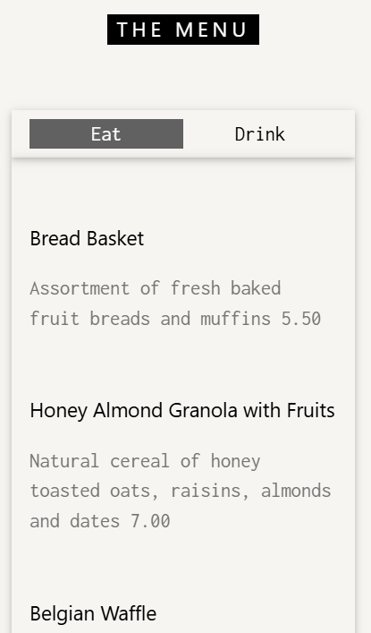
Tab Switching (Menu Section)
Single family (Inconsolata) across site → consistent vibe
Headings sized via inline style on hero (font-size:90px)
Critique: avoid inline styles; move headline size into CSS and clamp for responsiveness.

Slide 19
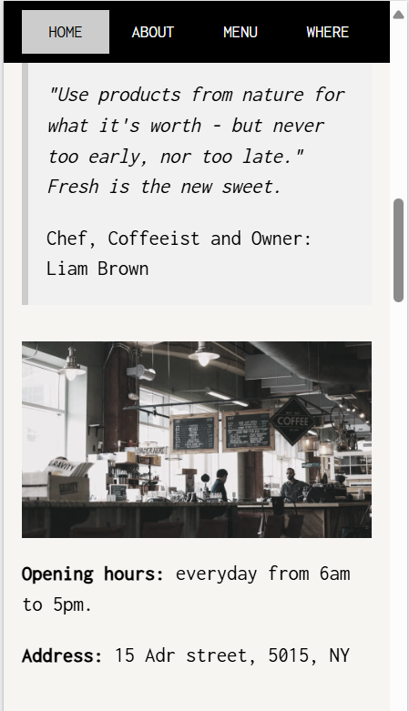
Color & contrast
High-contrast black nav over hero photo
Light “sand” body background (.w3-sand) → warm brand tone
Greys for secondary text for hierarchy
Note: Pass key contrast checks; ensure buttons meet WCAG AA (they do in dark mode).

Slide 20
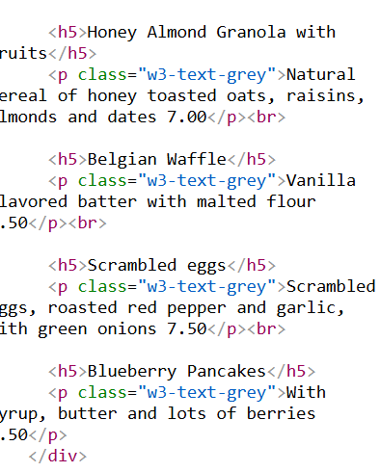
Menu Content Structure
Repeated pattern: <h5>Item</h5> + <p class="w3-text-grey">desc + price</p>
Simple to parse
Concerns consider <ul> with <li> for semantics or cards per item.

Slide 21
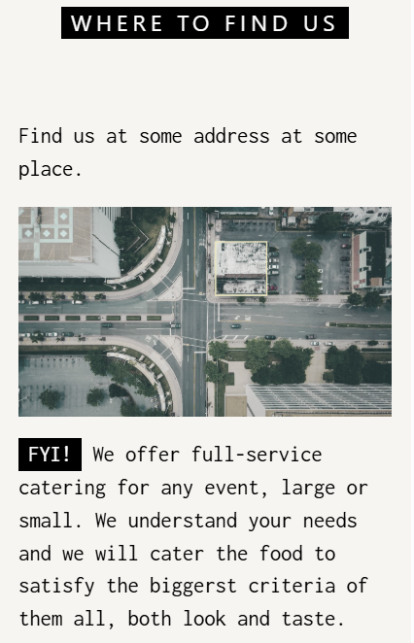
“Where to Find Us” Section
Heading tag badge, short intro, full-width map image
Catering FYI as emphasized note with .w3-tag
Contact form: Name, People, DateTime, Message + Submit Critique: add label elements + aria-describedby; ensure input name keys match backend needs.

Slide 22
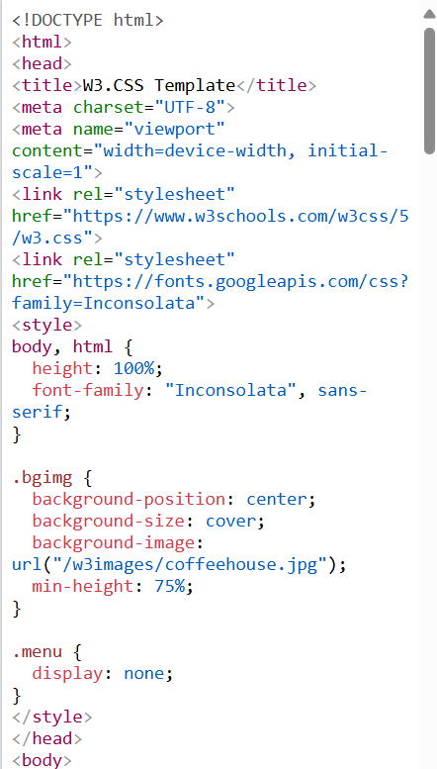
Code Organization & Maintainability
Strengths:
Clear section IDs; readable utilities
Minimal custom CSS; maintainable
Improvements:
Extract inline styles/script to separate files
Add component classes instead of only utilities for complex growth
Optimize images (size, format, loading="lazy")

Slide 23
Security & Progressive Enhancement
Form posts to /action_page.php (placeholder)
Add basic client validation constraints (e.g., min, max, required already used)
Consider CSP headers, SRI on CDNs, and graceful degradation if JS is off (show first tab by default in HTML)

Slide 24
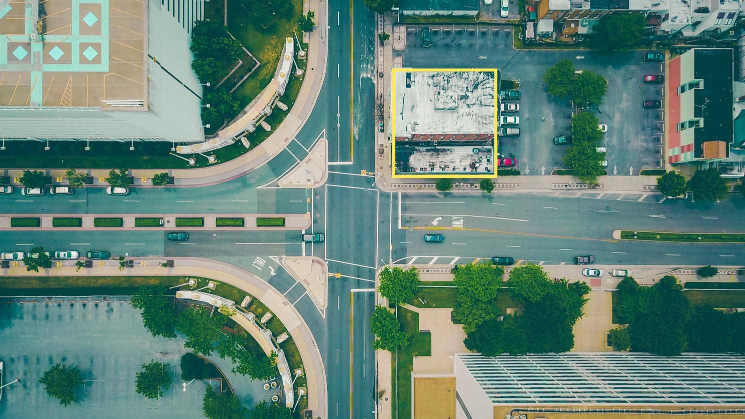
JavaScript learning layer
Learned how a simple function (openMenu) controls tabbed navigation.
Understood how getElementsByClassName + style.display work to show/hide sections.
Saw how classes are toggled (w3-dark-grey) to highlight the active tab.
Realized improvements could be made with event listeners + accessibility roles.
The template helped me see JS as the behavior layer — connecting user clicks to visible changes without needing a big framework.

Slide 25
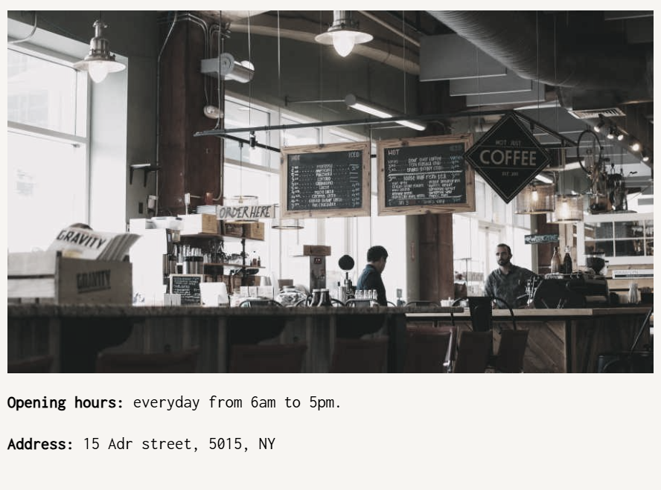
Key Takeaways
Semantics: ids + headings are good; wrap in <main>/<section> + add labels/ARIA for A11y
Layout: W3.CSS utilities give quick responsive structure; grid and spacing are clear
Interactivity: small, understandable JS for tabs; opportunity to modernize events/ARIA
Overall: clean, practical template that’s easy to adapt for a real café

Slide 26
Thank you!
Site Link

